Slide 1

OPEN SMART HOME SYSTEM

Slide 2

PROBLEM STATEMENT
AUTOMATION
SECURITY
HOW DO WE SAVE MORE ENERGY & ELECTRICITY?

Slide 3
AUTOMATION
Controlling:
Lights
Fans/ AC
Door Facial Recognition

Slide 4
SAVING ENERGY
Solar energy
Monitor extensions or socket – using thingspeak (notification if extension ae taking up too much energy
Control via cloud

Slide 5
SECURITY
Face ID
Notify user
Automate things
Reduce labour

Slide 6
SOLUTION
Using Open SHS.
The point of this framework to address the present issues of utilizing sensors just in home, by including a smart devices like the Arduino board that can screen and control the gadget at the family unit.
This it lessens cost in execution since it will control the gadgets utilizing sensors and high voltage gadgets will utilize transfer.

Slide 7
OVERALL AIM
SAVE ENERGY/ELECTRICITY
ENHANCE APPROPRIATE SECURITY SYSTEM

Slide 8
OBJECTIVES
Provide a user friendly and interactive system that is responsive without issues of delays or lag when a command is sent.
Develop a system that is cheaper than the current home automation systems that allows users to add devices to the system without incurring extra cost and no monthly subscriptions.
To make a system that is compatible with any device in the house and not limited to a number of devices.

Slide 9
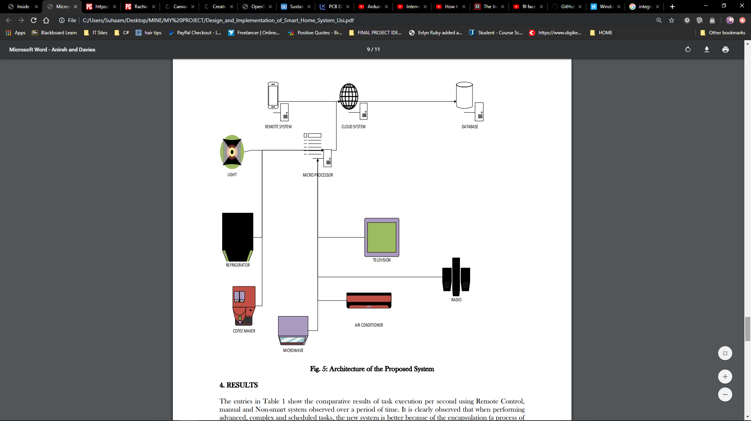
ARCHITECTURE

Slide 10
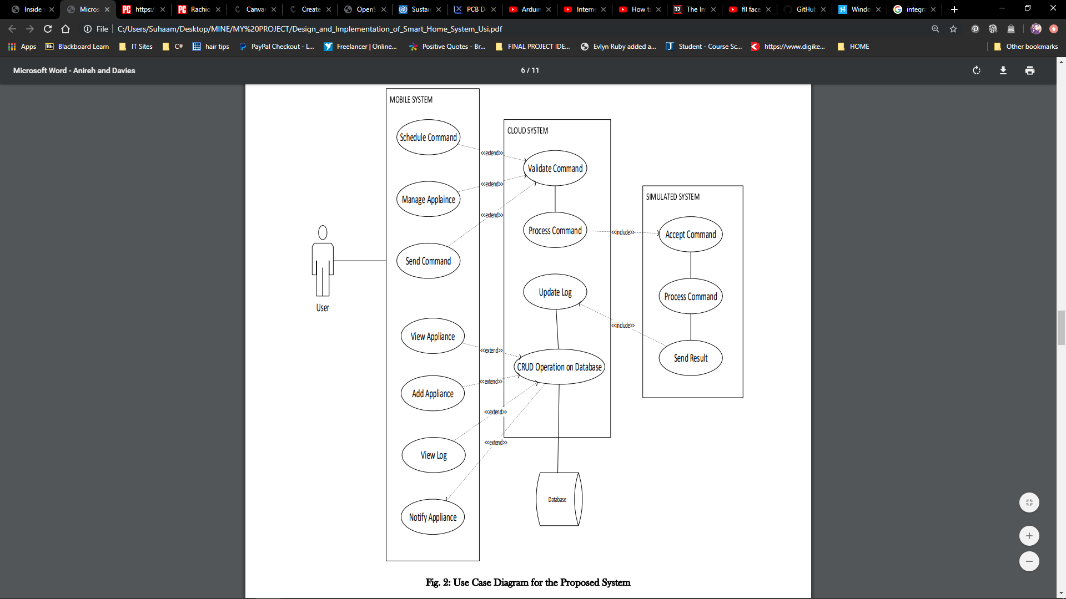
USE CASE

Slide 11

ADVANTAGE
Accessibility: allows it to work on multiple platforms, thus ensuring a better accessibility for the researchers and the participants
Flexibility: to simulate different scenarios according to their needs, by adding and/or removing sensors and smart devices
Interactivity: OpenSHS was done in a real-time fashion which facilitates the generation of richer datasets
Scalability: Our simulation tool is scalable and easily extensible to add new types of smart 488 devices and sensors.
Reproducibility: to produce datasets to validate other research activities

Slide 12
REQUIREMENTS
HARDWARES
SOFTWARES
COMMUNICATION
Technologies such as Wi-Fi, GSM, Bluetooth and ZigBee are used in some communication methods to control the devices and configurations. Such remotely enabled devices are particularly available in the market for end-users and cater to multiple objectives.

Slide 13
BUSINESS MODEL
Background & research
Challenges
Solution
Key value propositions

Slide 14
*BUDGET
50-100k for the hardware and software (REALISTIC FIGURE)

Slide 15
EVALUATION
COMPATIBILITY
COST
USABILITY

Slide 16
FUTURE & TIME FRAME
Smart homes are on the rise, which means the way we live our day to day lives is about to change drastically.

